Slide 1
Heart Failure Prediction
DSC 530 Final Project
Alan Donahue
Notes:
Dataset: https://www.kaggle.com/fedesoriano/heart-failure-prediction
fedesoriano. (September 2021). Heart Failure Prediction Dataset. Retrieved November 2021 from https://www.kaggle.com/fedesoriano/heart-failure-prediction.

Slide 2
Statistical Question
Am I able to predict heart disease from one of the following variables: age, sex, type of chest pain, the resting blood pressure, or the cholesterol level?

Slide 3
5 Chosen Variables
Age
Sex
ChestPainType
Cholesterol
RestingBP
Notes:
I chose these five variables due because I felt that they were going to be the most impactful on whether or not someone has heart disease. I believe they are the most impactful because of noticing all the high cholesterol ads as well as noticing that older men who aren’t in shape tend to more likely have heart disease.

Slide 4
Variables Defined
Age – age of the patient in years (integer)
Sex – sex of the patient (M for Male, F for Female)
ChestPainType – four different chest pain types
Categorized according to the presence of substernal chest pain or discomfort that was provoked by exertion or emotional stress and was relieved by rest and/or nitroglycerin
Typical Angina – have all 3 descriptors present
Atypical Angina – less than all 3 descriptors present
Non-anginal pain – pain that is not caused by heart disease or heart attack
Asymptomatic – chest pain that has either no symptoms or minimal symptoms or unrecognized symptoms

Slide 5
Variables Defined
Cholesterol – Serum cholesterol, represents the amount of total cholesterol in a person’s blood
RestingBP – resting blood pressure

Slide 6
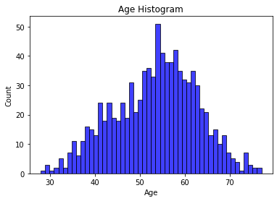
Age Histogram
Notes:
The age histogram was broken out by each age that was in the study. From a quick glance, the data looks great and fairly normalized though it may be a bit skewed to the right just by looking at it.

Slide 7
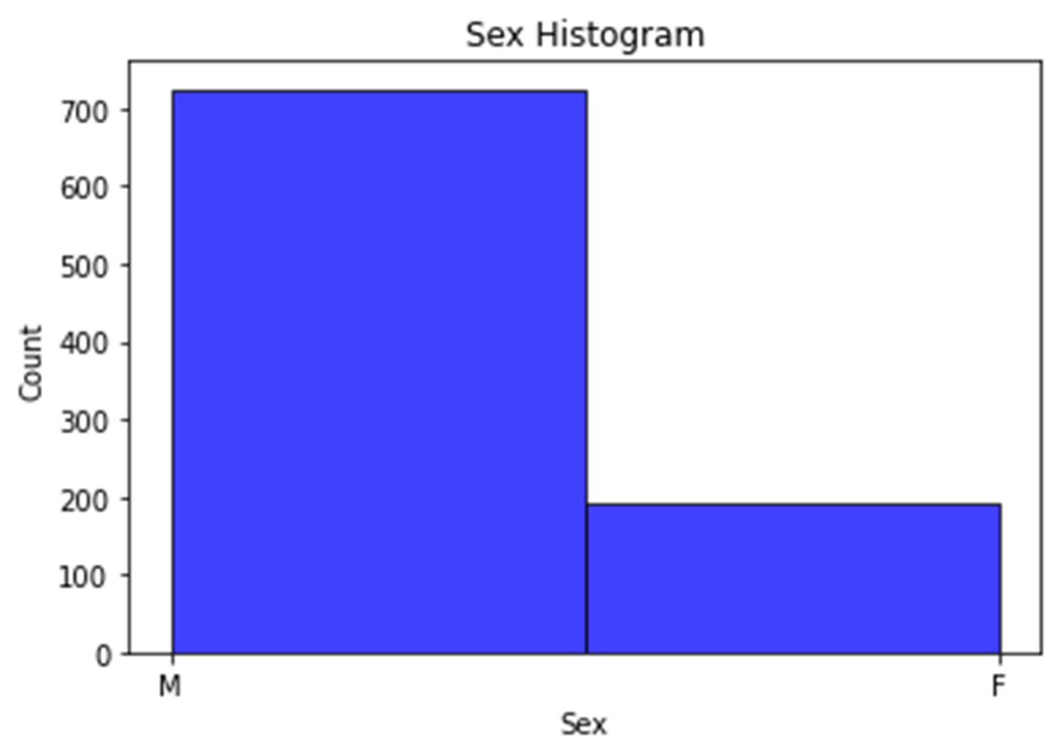
Sex Histogram
Notes:
The sex histogram shows that this study was overwhelmingly filled by males. This is something to keep in the back of my mind while conducting further data exploration. Having an imbalance between male and female may lead to inaccurate results when trying to predict the population.

Slide 8
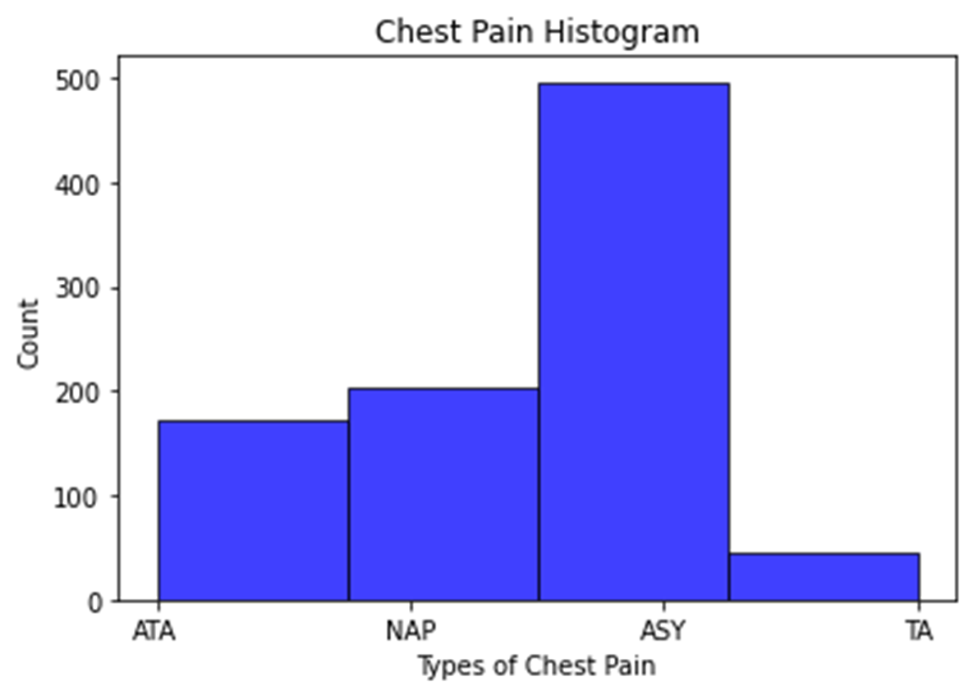
Chest Pain Histogram
Notes:
The chest pain histogram data looks good. Just like the sex histogram, I need to keep in the back of my mind that ASY chest pain is a huge portion of the study. Additionally, TA chest pain isn’t well represented in the study. This can affect making predictions on the population.

Slide 9
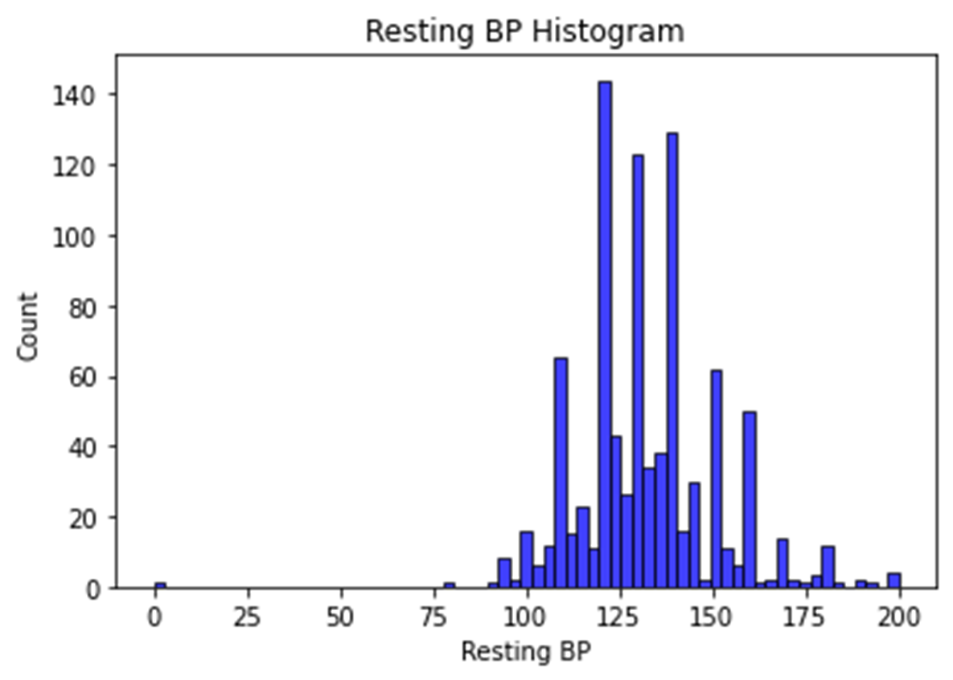
Resting BP Histogram
Notes:
The resting blood pressure histogram shows that it has outliers. There are a few cases where the resting BP is at 0. Doing further research on resting BP shows that this is not possible unless the individual was dead. For that reason, I assume that it was either entered in incorrectly or the resting BP wasn’t measured for those individuals. Moving forward, I plan to change the zeros to NaNs and omit them during the data analysis phase.

Slide 10
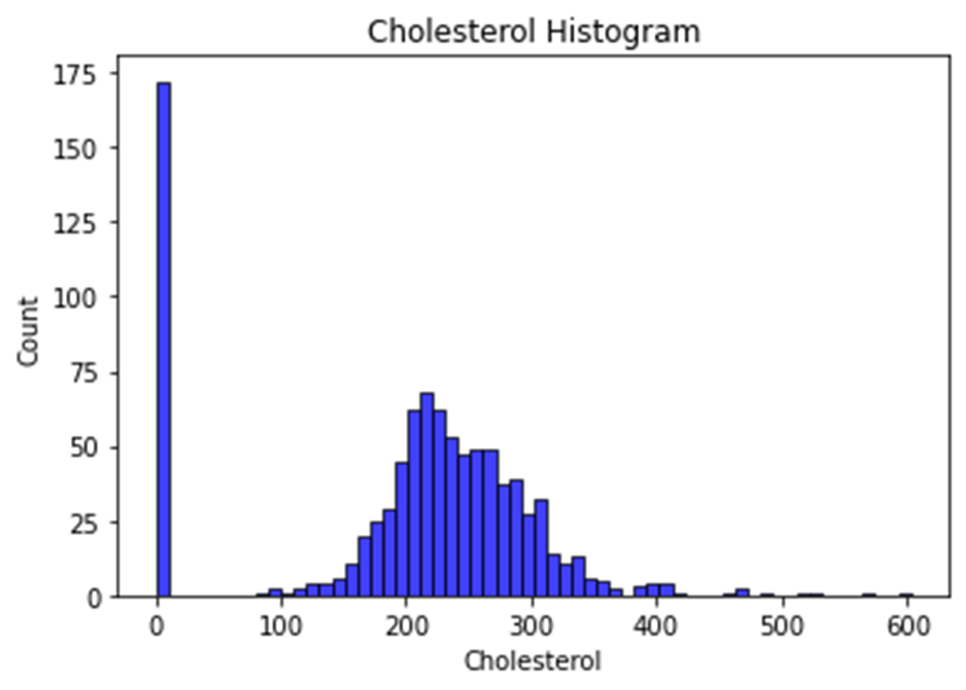
Cholesterol Histogram
Notes:
The cholesterol histogram also shows outliers. The biggest outliers that are shown are at 0 and the ones close to 600. After conducting further research, it seems impossible to have a cholesterol level of 0. For that reason, I believe that these individuals didn’t get their cholesterol levels measured and the 0 is just a placeholder. I intend to replace the zeros with NaNs and omit those records from further analysis.
In regard to the cholesterol close to 600, after further research, it seems possible to have that high of a cholesterol. However, at that point, it can be very deadly. For that reason, I am going to assume that those records are accurate.

Slide 11
Descriptive Stats
Stats | Age | Resting BP | Cholesterol
Var | 88.97 | 323.99 | 3499.13
Mode | 54 | 120 | 254
Count | 918 | 917 | 746
Mean | 53.51 | 132.54 | 244.63
Std | 9.43 | 17.99 | 59.15
Min | 28 | 80 | 85
25% | 47 | 120 | 207
50% | 54 | 130 | 237
75% | 60 | 140 | 275
Max | 77 | 200 | 603
Stats | Sex | Chest Pain
Mode | M | ASY
Count | 918 | 918
Unique | 2 | 4
Top | M | ASY
Freq | 725 | 496
Notes:
I broke out the descriptive stats above by continuous vs categorical variables. I was able to get more descriptive stats from the continuous variables versus the categorical variables. However, that makes sense considering what they are.

Slide 12
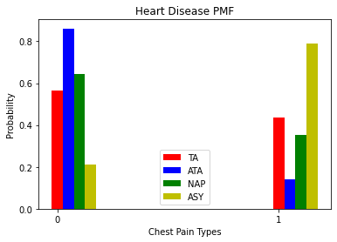
Heart Disease PMF
Notes:
For my PMF, I decided to focus on the chestPainType variable. As mentioned earlier in the slides, chestPainType is broken down into four different categories: TA, ATA, NAP, ASY. I compared each of the different categories to whether or not the individual has heart disease. 0 means that the individual didn’t have heart disease and 1 means that the individual had heart disease.
There were two categories that stood out to me. There was a real big difference in ATA and ASY. Those two categories seemed to act the opposite of each other. If individual has ATA, then there is over an 80% chance that they don’t have heart disease. However, if an individual has ASY there is almost an 80% chance they have heart disease.

Slide 13
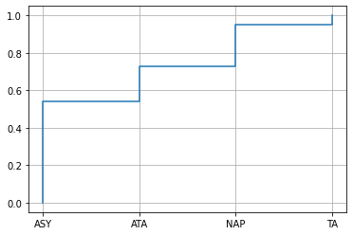
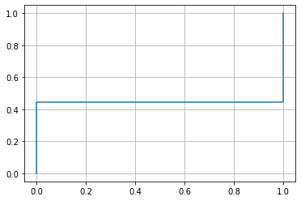
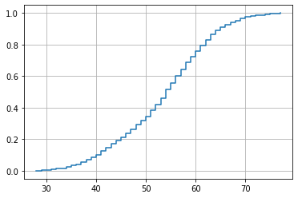
CDF
Chest Pain CDF
Heart Disease CDF
Age CDF
Notes:
I decided to do three different CDFs to see what each variable would look like. I chose chest pain, heart disease, and age. The CDF maps a value to the corresponding percentile rank.
The chest pain CDF shows that the ASY category in the chest pain variable has the biggest percentile compared to the other three. This matches with what the histogram showed earlier. This means that there are more ASY chest pains than the other types of chest pains.
The heart disease CDF shows that there is a bigger percentile of individuals who have heart disease than not in this dataset. This should continue to reflect in the data analysis.
The age CDF shows that there is a slightly bigger percentile of ages between 50 to 60 in the dataset. However, across the board, it looks like there is close equal representation. The CDF looks normalized to me.

Slide 14
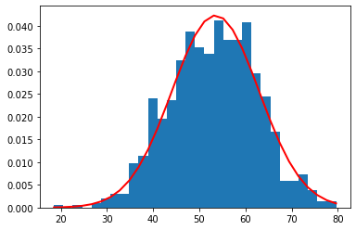
Analytic Distribution
Notes:
For the analytic distribution, I decided to look at the normal distribution of the variable age. Looking at the red line, the age distribution looks to be normalized albeit with a slight skew on the left-hand side. This looks to be the case because of a couple young aged individuals in the dataset.
It is good to know that the age variable has normal distribution because it shows that there is a good representation of age across the board in the study. It is one less variable that I need to worry about when it comes to affecting the results.

Slide 15
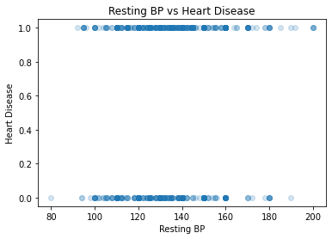
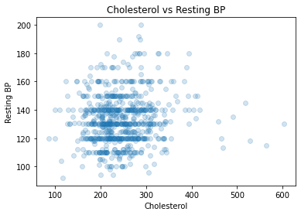
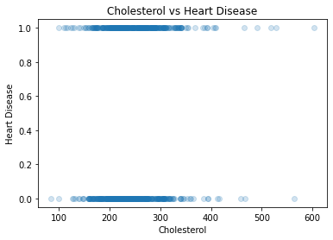
Scatterplots
Notes:
I decided to include three different scatterplots to compare the different variables. I chose to compare Resting BP and Heart Disease, Cholesterol and Resting BP, and Cholesterol and Heart Disease.
Looking at Resting BP and Heart Disease, the difference between having heart disease and not having heart disease was very small in regard to the resting BP. The range between the two of resting BP was very similar between heart disease and not heart disease.
Looking at the cholesterol and Resting BP, you can see that there are several horizontal lines cutting across the resting BP. This probably means that resting BP was rounded when entered into the dataset. Additionally, it looks like most individuals are between 100 to 300 in cholesterol and 100 160 in resting BP.
Looking at Cholesterol and Heart Disease, it is very similar to the Resting BP and Heart Disease scatterplot. Whether there is heart disease or not, the cholesterol levels fall around the same range between the two.

Slide 16
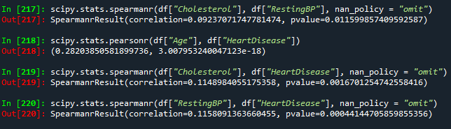
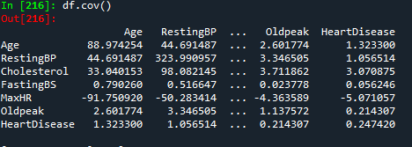
Covariance & Correlation
Notes:
Looking at the covariance, resting BP and cholesterol have a positive covariance with Heart Disease. This means that restingBP and cholesterol both vary in the same direction as Heart Disease when it varies.
The different correlation tests all came back statistically significant. The variable that had the biggest correlation with Heart Disease was Age. Cholesterol and RestingBP both had similar correlations to Heart Disease. Even though the correlation tests were statistically significant, the correlation numbers were small.

Slide 17
Hypothesis Test
Notes:
I used the scipy module to conduct the hypothesis test. The null hypothesis was that regardless of the range of resting BP, there wouldn’t be a case of heart disease. After conducting the test, it received a p value of zero which is statistically significant. This means that the resting BP does have a factor in whether or not an individual has heart disease.

Slide 18
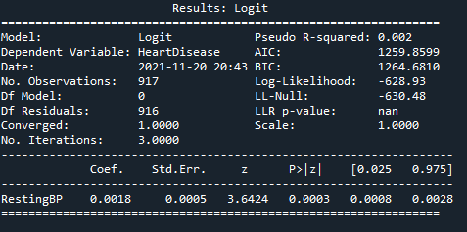
Logistic Regression
Notes:
I ran a logistic regression model because my dependent variable, Heart Disease, is categorical. My independent variable was resting BP. Looking at the results, it is statistically significant because the p-value is 0.0003 which is less than 0.05. However, the pseudo R-squared is very close to zero which means that the logistic model is not a good fit to the data.

Slide 19
Result
As this point, I would like to continue to dive back into the data to try to find a trend or pattern to be able to predict heart disease. Right now, it looks like the resting BP of an individual is not good enough to predict if that individual has heart disease, even though there is a small correlation between the two.
I think I would want to start getting a deeper look at the other variables: age, sex, type of chest pain, and even cholesterol.

Slide 20
References
Hermann, L. K., Weingart, S. D., Yoon, Y. M., Genes, N. G., Nelson, B. P., Shearer, P. L., . . . Henzlova, M. J. (2010). Comparison of frequency of inducible myocardial ischemia in patients presenting to emergency department with typical versus atypical or nonanginal chest pain. National Library of Medicine, Abstract.
Huizen, J., & Soliman, M. (2021, September 21). What is serum cholesterol? Retrieved from Medical News Today: https://www.medicalnewstoday.com/articles/321519
Non-Cardiac Chest Pain. (2015, June 25). Retrieved from Cleveland Clinic: https://my.clevelandclinic.org/health/diseases/15851-gerd-non-cardiac-chest-pain
Silent Heart Attacks: What Do Asymptomatic Signs of a Heart Attack Mean? (n.d.). Retrieved from Elite Care: https://elitecarehouston.com/silent-heart-attacks-what-do-asymptomatic-signs-of-a-heart-attack-mean/

